Slide 1
STGATT: Sandwich-style Spatial Temporal GNN for Data Imputation in Wireless Sensor Networks
Xuanhao Luo, Jinming Xing, Xiaochun Liang
https://github.com/XingJinming-real/STGATT--Sandwich-style-spatial-temporal-GNN-for-data-imputation

Slide 2
Introduction

Slide 3
Problem Statement

Slide 4
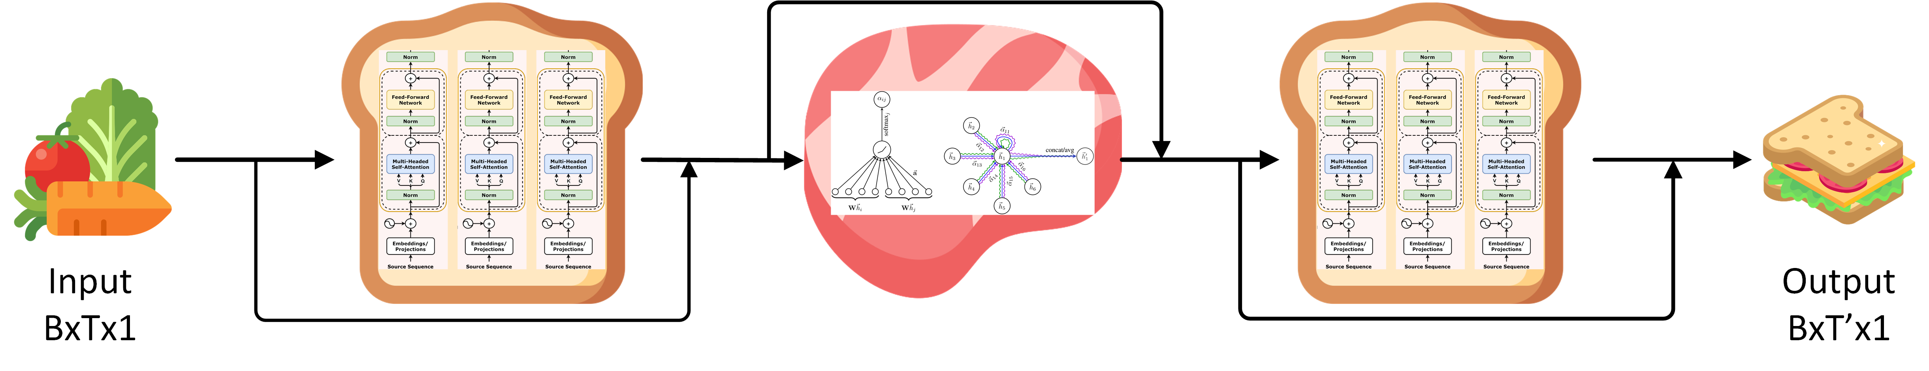
Methodology
Framework Overview
STGATT: Sandwich Transformer-GAT-Transformer Network
Transformer (encoder-only) is used for temporal dependencies modeling
Graph Attention Network is used for spatial information aggregation
B is the number of sensers, T is the context window, 1 is the feature num

Slide 5
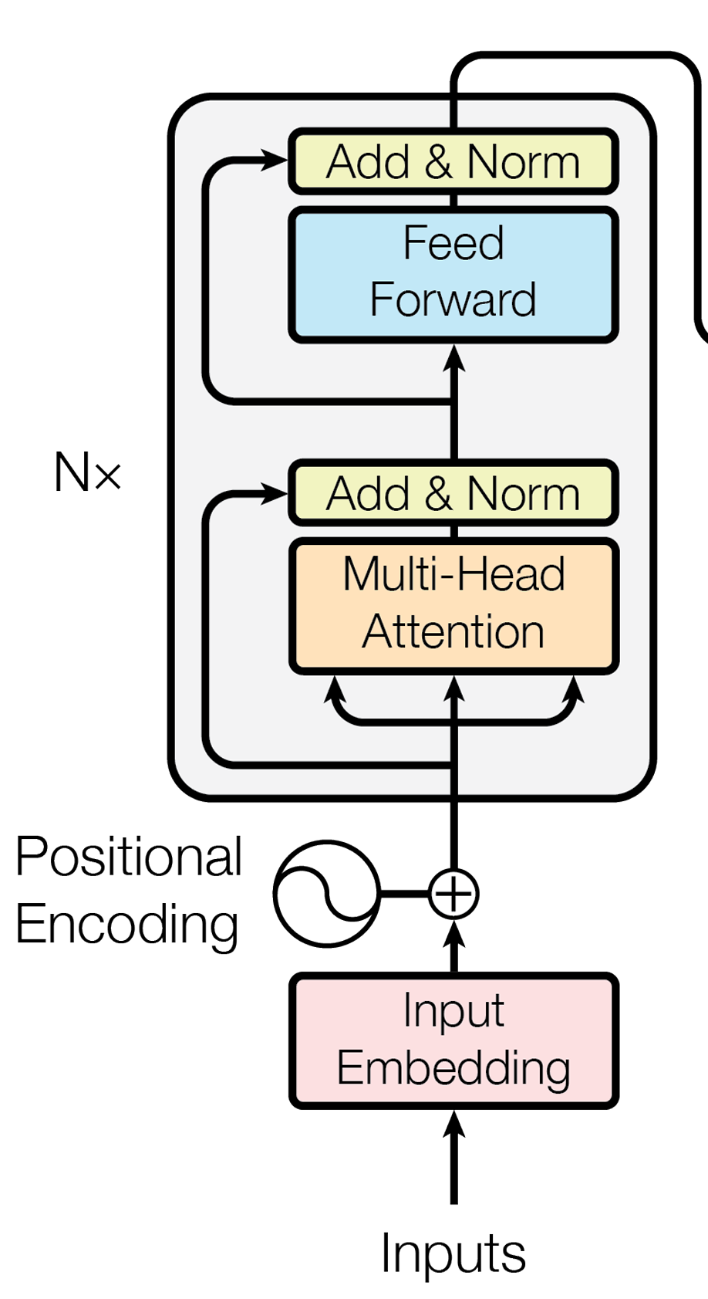
Methodology
1. Transformer (encoder-only)
Why encoder-only, rather than encoder-decoder or decoder-only?
The main difference between encoder and decoder
Key parts of transformer encoder
Positional encoding
Attention
Layer norm

Slide 6
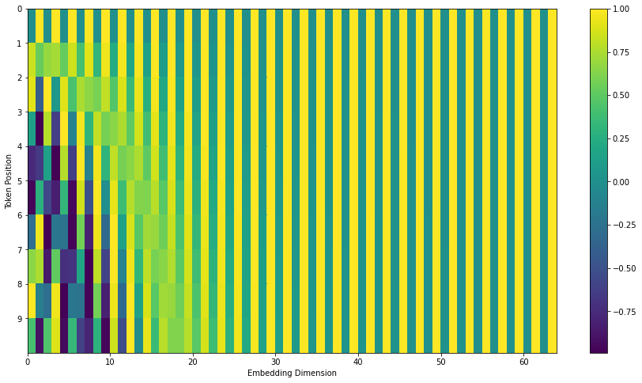

Methodology
1.1 Positional encoding
As proposed in the original transformer paper, the pe is fixed, formulated as $PE_{pos,2i}=\sin{(pos/{10000}^{\frac{2i}{d_{model}}}})$
$$PE_{pos,2i+1}=\cos{(pos/{10000}^{\frac{2i}{d_{model}}}})$$
The purpose of pe is to add let the model know the relevant position of each token, as the mechanism of attention ignores it.

Slide 7
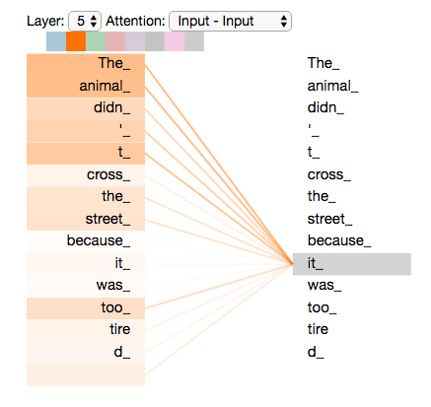
Methodology
1.2 Attention
Attention is used for modeling the relation between any two token.
Example:
”The animal didn't cross the street because it was too tired”

Slide 8

Methodology
1.2.1 Single-head attention
For each token, we get its embedding denoted as $X$
Then, three additional tensors Q,K,V are derived from it.
Q (query): $Q=W_{q}X$
K (key): $K=W_{k}X$
V (value): V$=W_{v}X$
where $W_{q}, W_{k}, W_{v}$ are learnable parameters

Slide 9

Methodology
1.2.1 Single-head attention
As their name suggested, Q is used for query, K is key corresponding to Q, V is the real information.
$$X_{out}=softmax\left(\frac{QK^{T}}{\sqrt{d_{k}}}V\right)$$
$\sqrt{d_{k}}$ is normalization coefficient
Actically, $X_{out}$ is the weighted sum of all tokens, where the weight $\frac{QK^{T}}{\sqrt{d_{k}}}$ is learned automatically

Slide 10
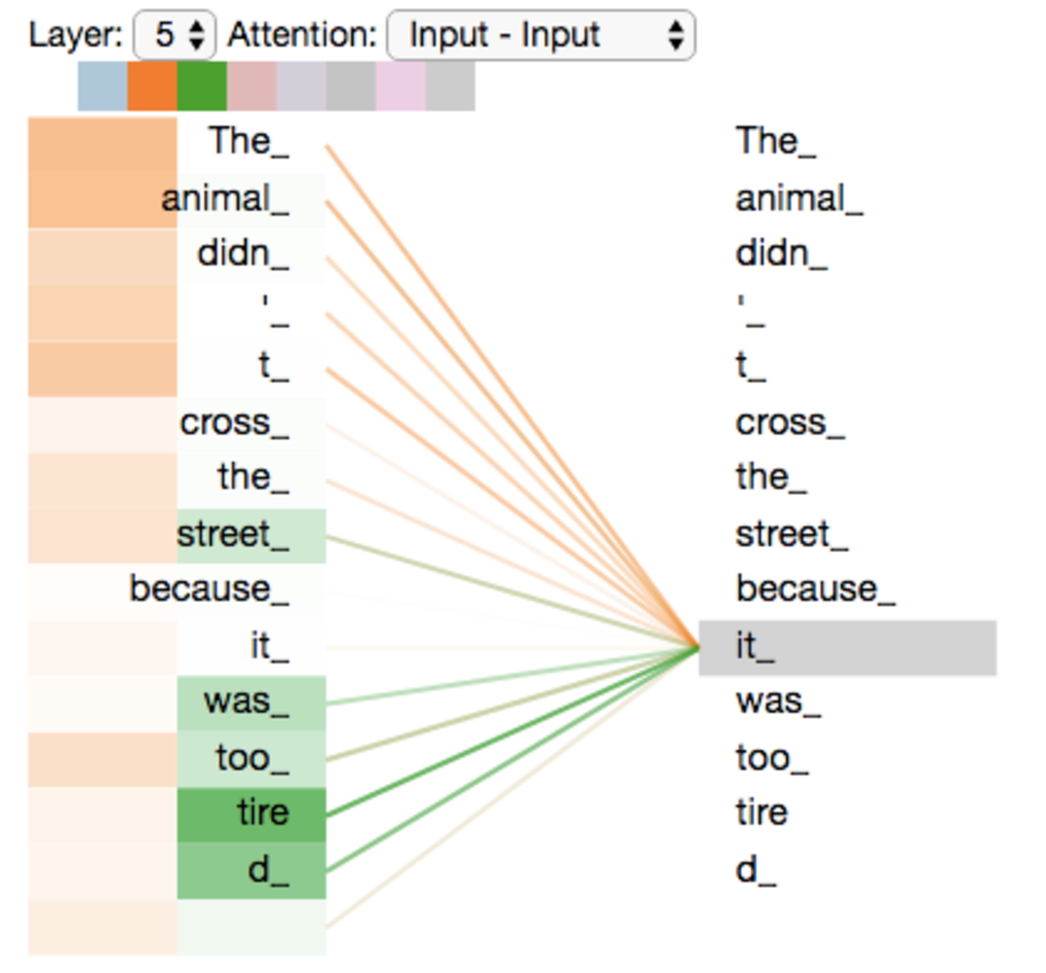

Methodology
1.2.2 Multi-head attention
Apparently, one set of weights is not enough, multiple sets of weights can capture information from various perspectives
$$X_{out}^{h}=softmax\left(\frac{Q_{h}K_{h}^{T}}{\sqrt{d_{k}}}V_{h}\right)$$
$$X_{out}^{m}=W\left(∥_{1}^{h}X_{out}^{h}\right)$$
where $W$ is aggregation weight matrix $||$ means concatenation

Slide 11

Methodology
1.3 Layer Normalization
Given a input vector $x=\left[x_{1},x_{2},⋯,x_{d}\right]$, $y=γ⊙\frac{x−μ}{\sqrt{σ^{2}+ε}}+β$, where $μ$ is the mean, $σ^{2}$ is the variance, $ε$ is $1e^{−5}$ or $1e^{−6}$ to avoid divided by 0,
$γ=\left[γ_{1},γ_{2},⋯,γ_{d}\right]$, $β=\left[β_{1},β_{2},⋯,β_{d}\right]$, $⊙$ means element-wise product
Feature | Batch Normalization (BatchNorm) | Layer Normalization (LayerNorm)
Normalization Axis | Across the batch | Across features
Dependency on Batch Size | Yes | No
Applicability | Image data and fixed-size data | Sequential and variable-length data
Architectural Suitability | Convolutional networks (e.g., CNNs) | Transformers, RNNs, NLP models

Slide 12
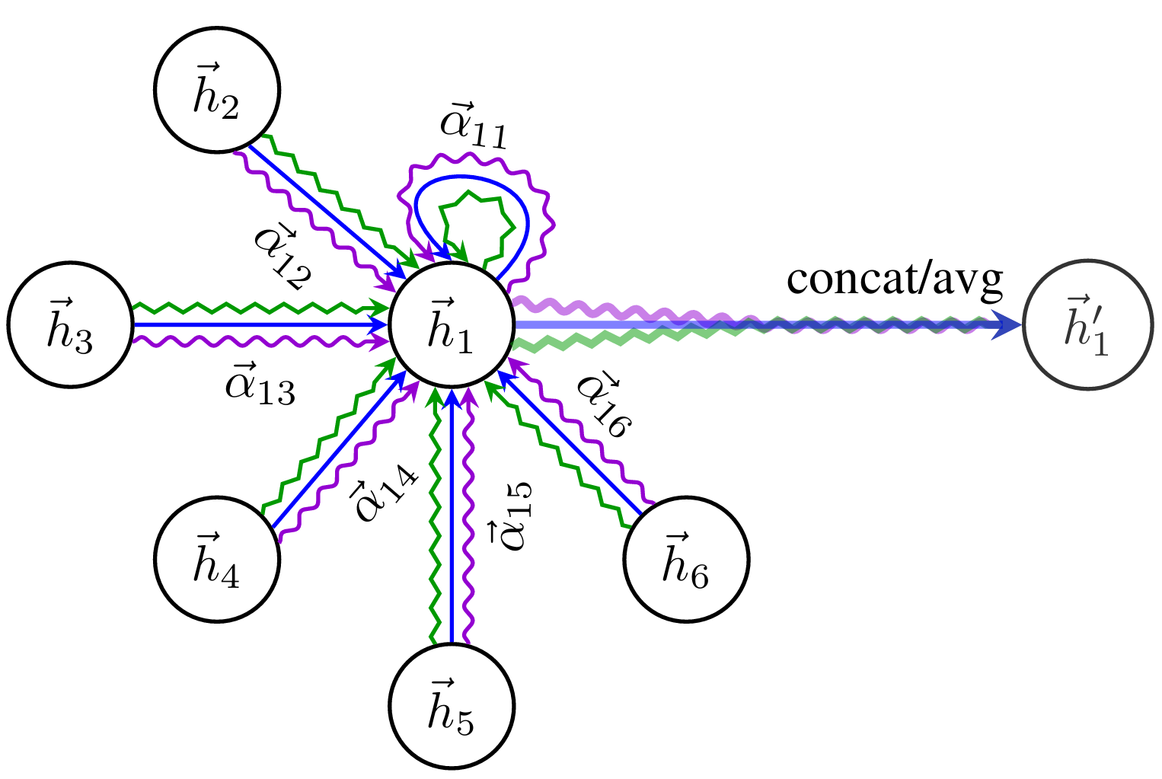
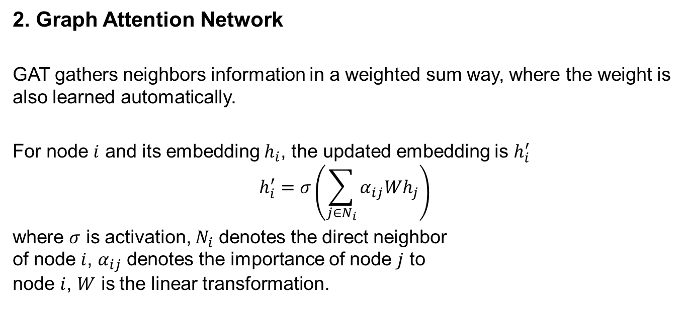
Methodology
2. Graph Attention Network
GAT gathers neighbors information in a weighted sum way, where the weight is also learned automatically.
For node $i$ and its embedding $h_{i}$, the updated embedding is $h_{i}^{′}$
$$h_{i}^{′}=σ\left(\sum_{j∈N_{i}}{α_{ij}Wh_{j}}\right)$$
where $σ$ is activation, $N_{i}$ denotes the direct neighbor of node $i$, $α_{ij}$ denotes the importance of node $j$ to node $i$, $W$ is the linear transformation.

Slide 13
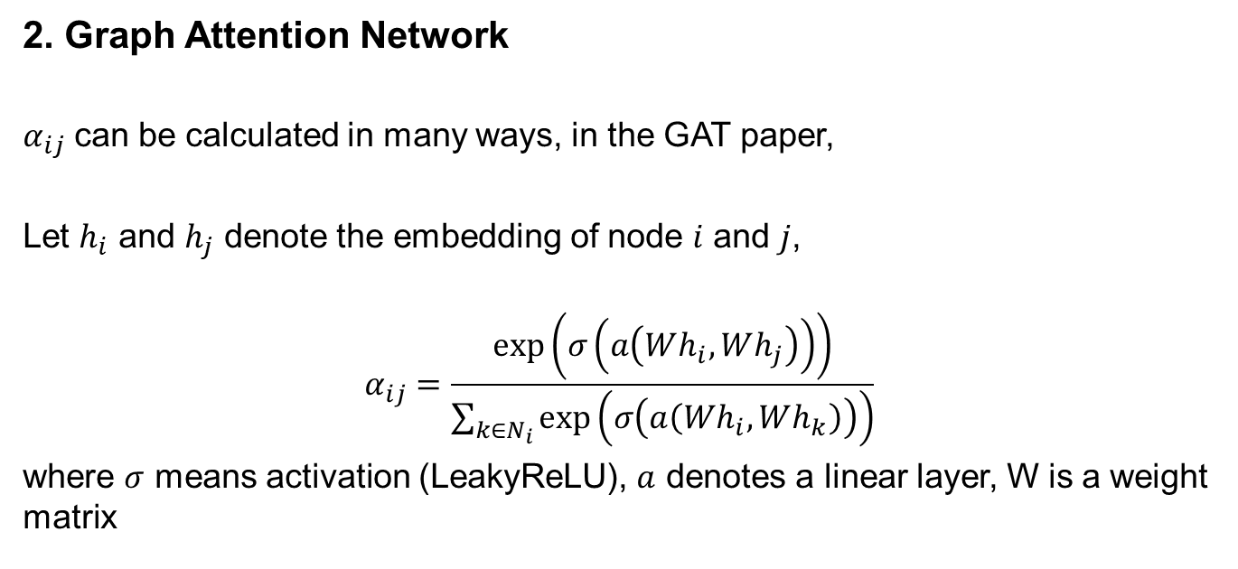
Methodology
2. Graph Attention Network
$α_{ij}$ can be calculated in many ways, in the GAT paper,
Let $h_{i}$ and $h_{j}$ denote the embedding of node $i$ and $j$,
$$α_{ij}=\frac{\exp\left(σ\left(a\left(Wh_{i},Wh_{j}\right)\right)\right)}{\sum_{k∈N_{i}}{\exp\left(σ\left(a\left(Wh_{i},Wh_{k}\right)\right)\right)}}$$
where $σ$ means activation (LeakyReLU), $a$ denotes a linear layer, W is a weight matrix

Slide 14
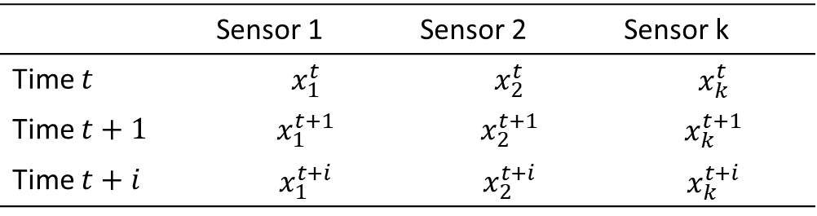
Methodology
3. STGATT
In the given dataset, there’s no adjacency matrix or edge index.
How do we utilize GNN in this case?
We proposed a dynamic graph generation method can self-adaptively learn the underling connectiveness, i.e. adjacency matrix.
 | Sensor 1 | Sensor 2 | Sensor k
Time $t$ | $$x_{1}^{t}$$ | $$x_{2}^{t}$$ | $$x_{k}^{t}$$
Time $t+1$ | $$x_{1}^{t+1}$$ | $$x_{2}^{t+1}$$ | $$x_{k}^{t+1}$$
Time $t+i$ | $$x_{1}^{t+i}$$ | $$x_{2}^{t+i}$$ | $$x_{k}^{t+i}$$

Slide 15
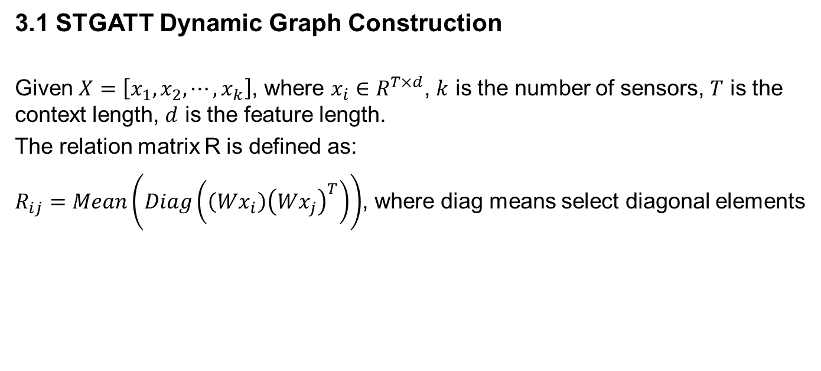
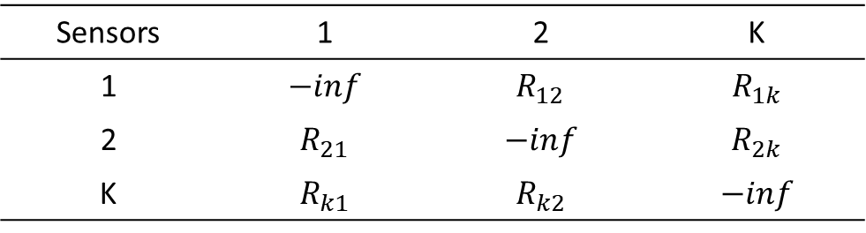
Methodology
3.1 STGATT Dynamic Graph Construction
Given $X=\left[x_{1},x_{2},⋯, x_{k}\right]$, where $x_{i}∈R^{T×d}$, $k$ is the number of sensors, $T$ is the context length, $d$ is the feature length.
The relation matrix R is defined as:
$R_{ij}=Mean\left(Diag\left(\left(Wx_{i}\right){\left(Wx_{j}\right)}^{T}\right)\right)$, where diag means select diagonal elements
Sensors | 1 | 2 | K
1 | $$−inf$$ | $$R_{12}$$ | $$R_{1k}$$
2 | $$R_{21}$$ | $$−inf$$ | $$R_{2k}$$
K | $$R_{k1}$$ | $$R_{k2}$$ | $$−inf$$

Slide 16
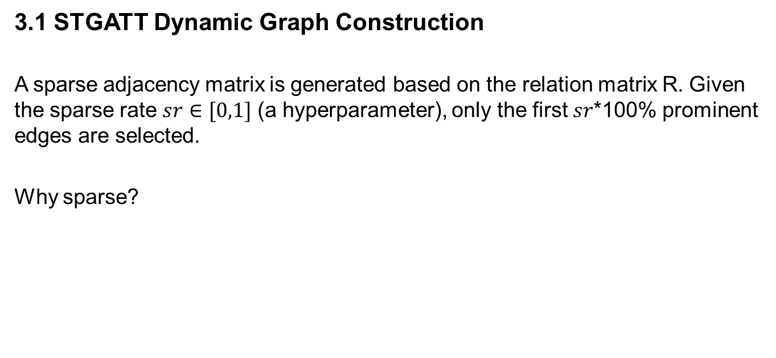
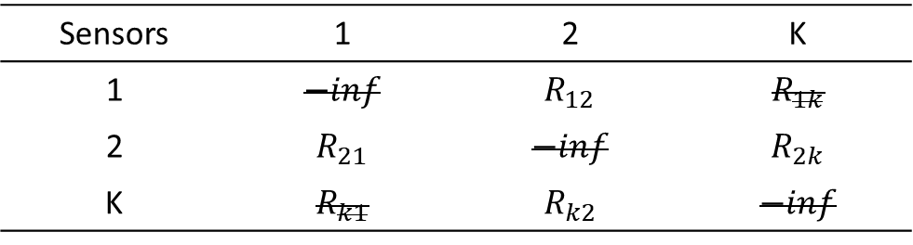
Methodology
3.1 STGATT Dynamic Graph Construction
A sparse adjacency matrix is generated based on the relation matrix R. Given the sparse rate $sr∈[0,1]$ (a hyperparameter), only the first $sr$*100% prominent edges are selected.
Why sparse?
Sensors | 1 | 2 | K
1 | $$−inf$$ | $$R_{12}$$ | $$R_{1k}$$
2 | $$R_{21}$$ | $$−inf$$ | $$R_{2k}$$
K | $$R_{k1}$$ | $$R_{k2}$$ | $$−inf$$

Slide 17

Methodology
3.1 STGATT Dynamic Graph Construction
For each training sample $X$, ($B×T×d)$, where B is number of sensors, we generate its corresponding adjacency matrix, $E$
X and E are then fed into the STGATT framework

Slide 18
Methodology
3. STGATT
Additional Notes
Sparse rate is set to 0.5 when training
The context length is 16
Learnable pe is used rather than fixed one
Residual connections are adopted
More settings will be introduced experiment section

Slide 19
Experiments
Dataset
Baseline
Settings and evaluation metrics
Results

Slide 20
Conclusion

Slide 21
QA

